Slide 1

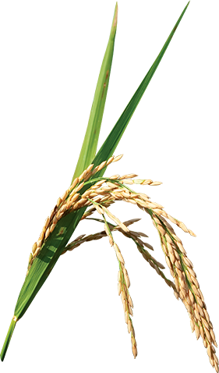
A Study on Paddy Disease Detection using Color Co-occurrence Features
Supervised by
Dr. Sk. Mohammad Masudul Ahsan
Professor
Department of Computer Science and Engineering
Khulna University of Engineering and Technology
Presented By
Md. Jahirul Islam
Roll: 1307035 Protap Chandra Ghose
Roll: 1307046

Slide 2
Out-Line
Introduction
Why choose paddy disease detection?
Background study
Workflow
Model Overview
Conclusion
Reference

Slide 3
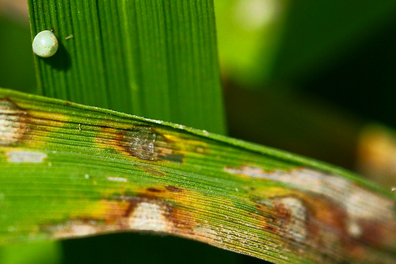
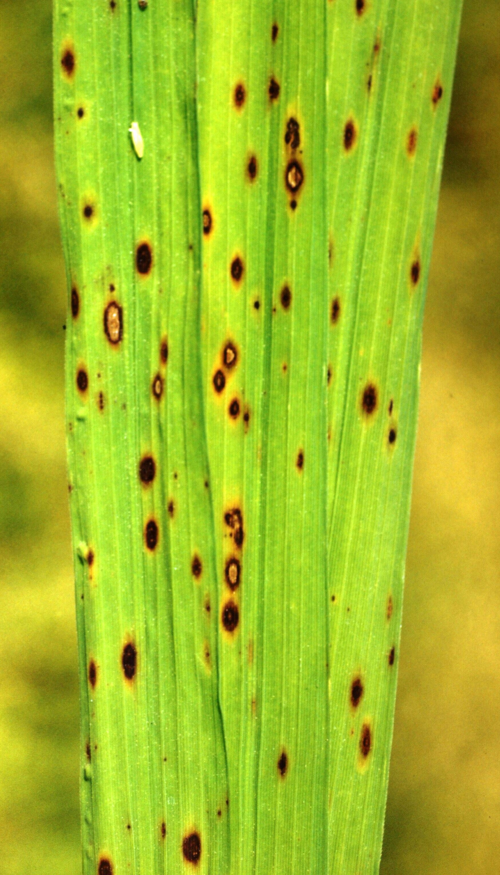
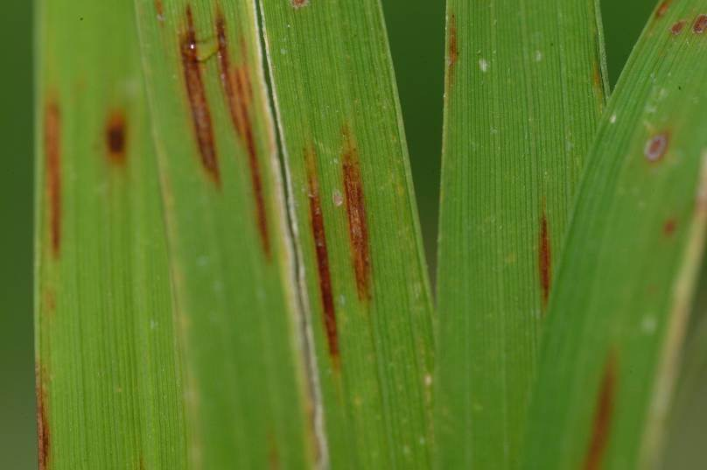
Introduction
Paddy Diseases
Paddy
Disease
[1]
Paddy Blust
[3]
Brown Spot
etc.
[2]
Narrow Brown Spot
ref:
http://farm6.static.flickr.com/5018/5576376970_659c176dbe.jpg
http://www.agriskmanagementforum.org/sites/agriskmanagementforum.org/files/narrow%20brown%20spot.jpg
https://bugwoodcloud.org/images/768x512/5390491.jpg

Slide 4
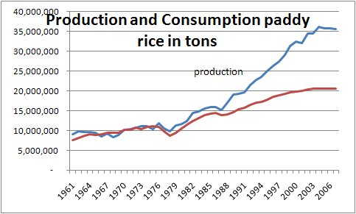
Why Paddy Diseses Detection?
As an agricultural country, Bangladesh gets it’s one-sixth of national income from rice
About 10.5 million hectares lands produce 25.0 million tons rice ever year [2014]
Now govt.’s target is to produce another 30 millions over the next 20 years
consumption
[1]
[1]
Rice Production Statistics
Main Obstacle for gaining the target is those paddy diseases
If disesases can detect easily with image processing, taking action will be faster
ref:
1. ref::http://www.ruraldevelopment.info/siteimages/pro%20and%20con%20rice.jpg

Slide 5

Background Study
Studied about paddy diseases and list three diseases for our work
Visited local agriculture office
Gone through some related work and summarized
[1]
Reading Report
ref:
1. http://s3.amazonaws.com/libapps/accounts/91304/images/reading_report.png

Slide 6
Workflow
Start
Image Acquisition
Image Processing
Feature Extraction
Image Classification
Disease Detection
End
Fig: Block Diagram of proposed methodology

Slide 7

Image Acquisition
Image acquisition is the first step as it is to get the dataset for training and testing any system
Images has been taken from the internet
Total images 218
Paddy Blast 87
Brown Spot 56
Narrow Brown Spot 35
Normal 10
Other 30
[1]
Internet
ref:
1. https://pixabay.com/en/internet-global-earth-communication-1181587/

Slide 8
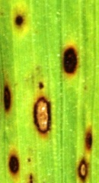
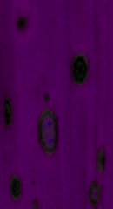
Image Processing
Objective is to obtain better image with approximation of human color perception
Lab image is produced form RGB image
RGB Image
Lab Image

Slide 9
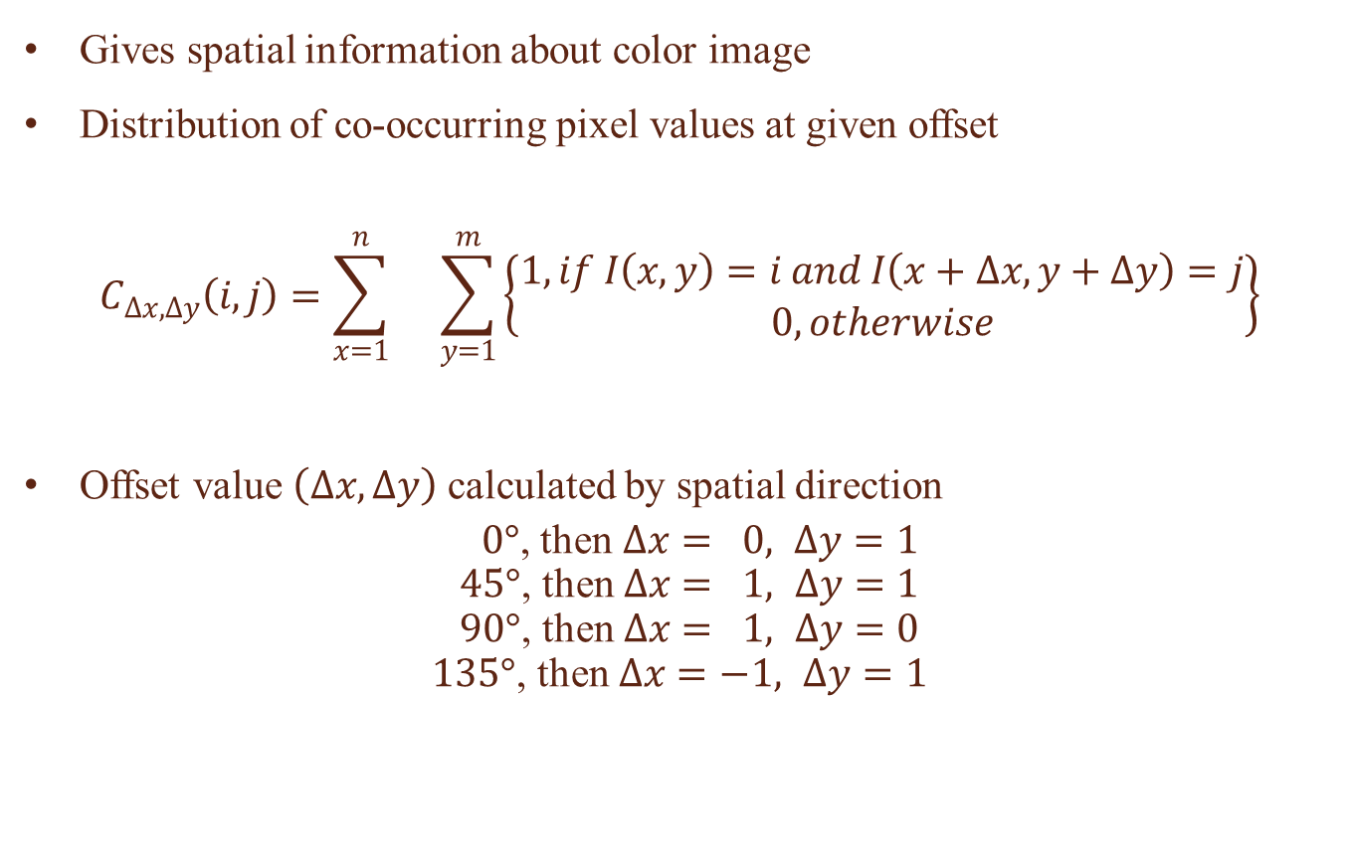
Feature Extraction [CCM]
Gives spatial information about color image
Distribution of co-occurring pixel values at given offset
$$C_{∆x, ∆y}\left(i, j\right)=\sum_{x=1}^{n}{}\sum_{y=1}^{m}{\left\{\begin{matrix}1, if I\left(x, y\right)=i and I\left(x+∆x, y+∆y\right)=j \\ 0, otherwise\end{matrix}\right\}}$$
Offset value $\left(∆x, ∆y\right)$ calculated by spatial direction
$0°$, then $∆x= 0, ∆y=1$
$45°$, then $∆x= 1, ∆y=1$
$90°$, then $∆x= 1, ∆y=0$
$135°$, then $∆x=−1, ∆y=1$

Slide 10
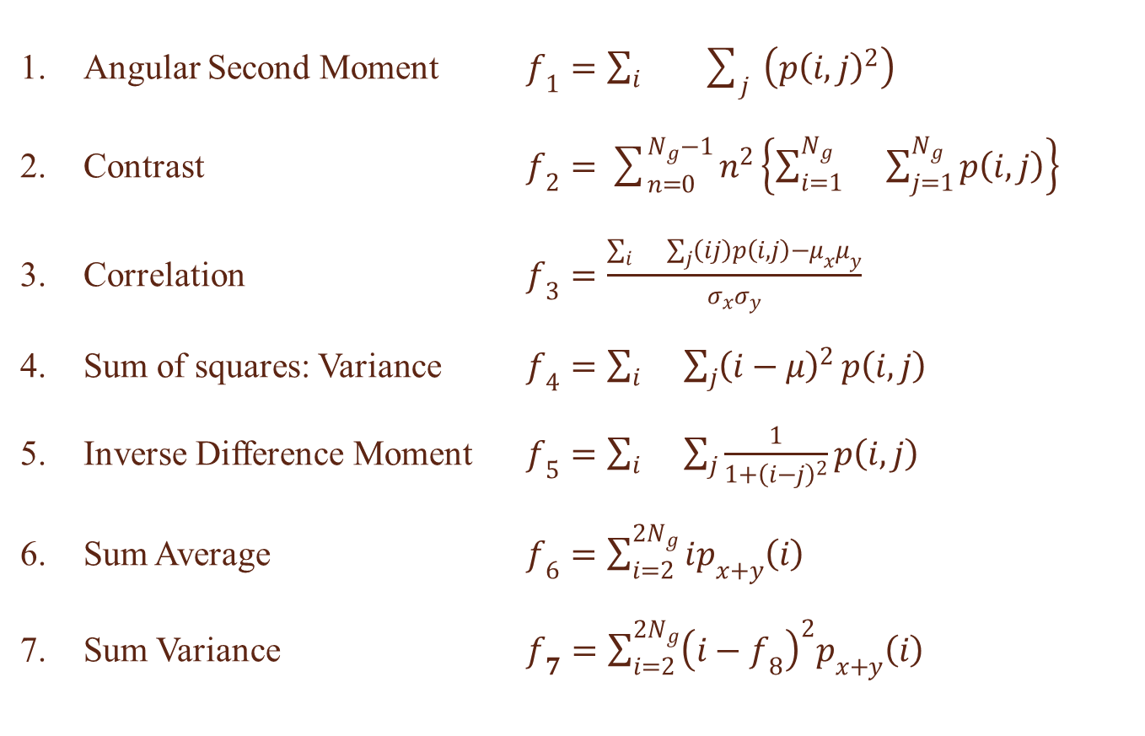
Textural Features
Angular Second Moment $f_{1}=\sum_{i}{}\sum_{j}{\left(p{\left(i, j\right)}^{2}\right)}$
Contrast $f_{2}=\sum_{n=0}^{N_{g}−1}{n^{2}}\left\{\sum_{i=1}^{N_{g}}{}\sum_{j=1}^{N_{g}}{p\left(i, j\right)}\right\}$
Correlation $f_{3}=\frac{\sum_{i}{}\sum_{j}{\left(ij\right)}p\left(i, j\right)−μ_{x}μ_{y}}{σ_{x}σ_{y}}$
Sum of squares: Variance $f_{4}=\sum_{i}{}\sum_{j}{{\left(i−μ\right)}^{2}}p\left(i, j\right)$
Inverse Difference Moment $f_{5}=\sum_{i}{}\sum_{j}{\frac{1}{1+{\left(i−j\right)}^{2}}}p\left(i, j\right)$
Sum Average $f_{6}=\sum_{i=2}^{2N_{g}}{ip_{x+y}\left(i\right)}$
Sum Variance $f_{7}=\sum_{i=2}^{2N_{g}}{{\left(i−f_{8}\right)}^{2}p_{x+y}\left(i\right)}$

Slide 11
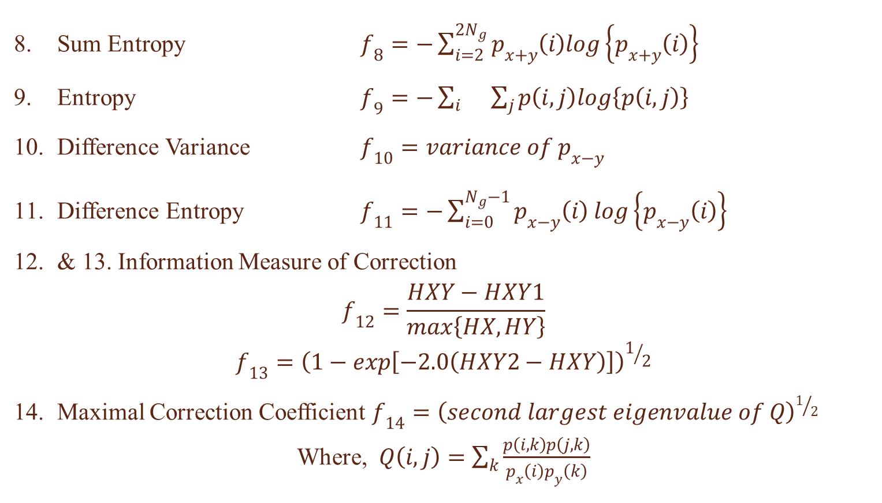
Textural Features [Cont.]
Sum Entropy $f_{8}=−\sum_{i=2}^{2N_{g}}{p_{x+y}\left(i\right)log\left\{p_{x+y}\left(i\right)\right\}}$
Entropy $f_{9}=−\sum_{i}{}\sum_{j}{p\left(i,j\right)log\left\{p\left(i,j\right)\right\}}$
Difference Variance $f_{10}=variance of p_{x−y}$
Difference Entropy $f_{11}=−\sum_{i=0}^{N_{g}−1}{p_{x−y}\left(i\right) log\left\{p_{x−y}\left(i\right)\right\}}$
& 13. Information Measure of Correction
$$f_{12}=\frac{HXY−HXY1}{max\left\{HX, HY\right\}}$$
$$f_{13}={\left(1−exp\left[−2.0\left(HXY2−HXY\right)\right]\right)}^{1/2}$$
Maximal Correction Coefficient $f_{14}={\left(second largest eigenvalue of Q\right)}^{1/2}$
Where, $Q\left(i, j\right)=\sum_{k}{\frac{p\left(i,k\right)p\left(j,k\right)}{p_{x}\left(i\right)p_{y}\left(k\right)}}$

Slide 12
Feature Selection
Homogeneity
Angular Second Moment(ASM)
Energy
Information Measure of Correlation 1
Information Measure of Correlation 2

Slide 13
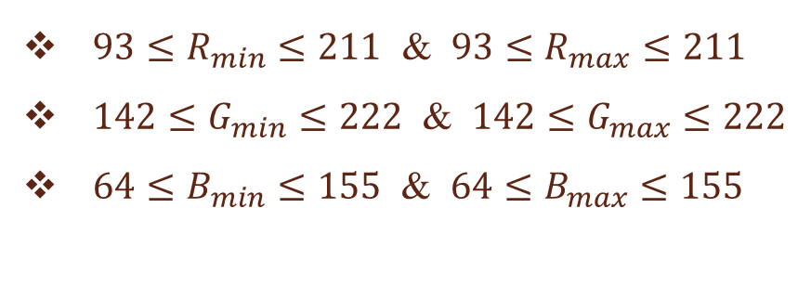
Classification
RGB Calculation
RGB calculation is used to find out the normal leaf image
Whole image scanned to calculate maximum and minimum value for each channel
${93≤R}_{min}≤211$ & ${93≤R}_{max}≤211$
${142≤G}_{min}≤222$ & ${142≤G}_{max}≤222$
${64≤B}_{min}≤155$ & ${64≤B}_{max}≤155$

Slide 14
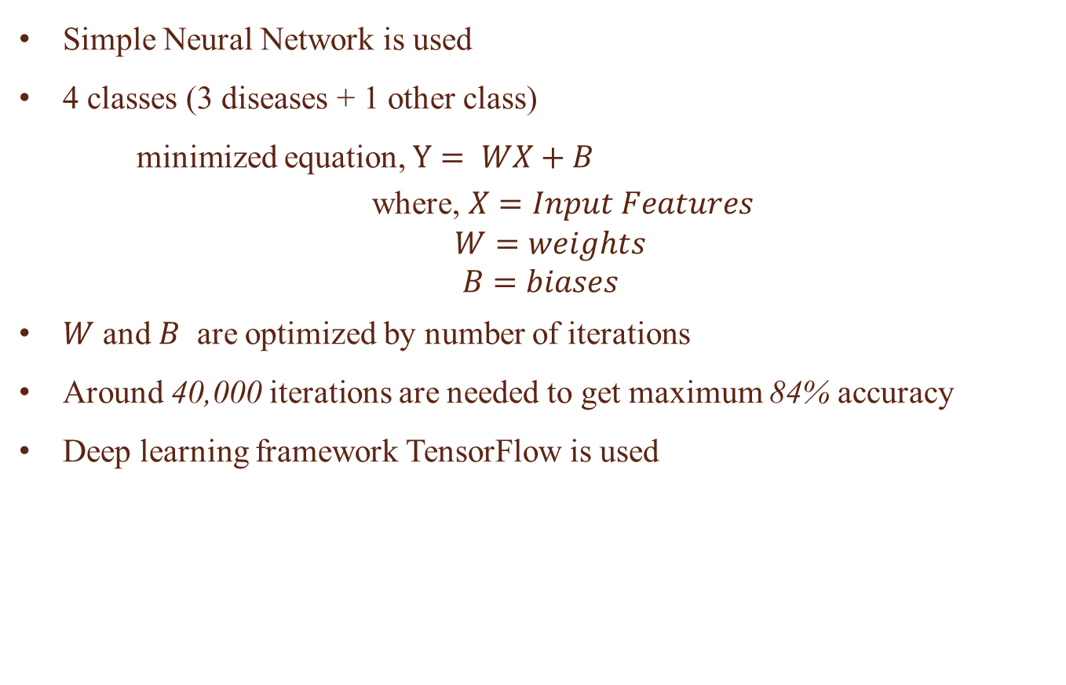
Classification [Cont.]
Simple Neural Network is used
4 classes (3 diseases + 1 other class)
minimized equation, $Y= WX+B$
where, $X=Input Features$
$W=weights$
$B=biases$
$W$ and $B$ are optimized by number of iterations
Around 40,000 iterations are needed to get maximum 84% accuracy
Deep learning framework TensorFlow is used

Slide 15
Model Overview
Training
Testing
RGB Image
Input Image
Lab Image
RGB
Calculation
CCM
Normal?
yes
Normal
Image
Feature
no
Trained Model
Model
Trained Model
Output
Prediction

Slide 16








Result Analysis
Paddy Blast
Correctly Classified
(Accuracy = 88.51%)
Incorrectly Classified

Slide 17








Result Analysis [cont.]
Brown Spot
Correctly Classified
(Accuracy = 75.00%)
Incorrectly Classified

Slide 18








Result Analysis [cont.]
Narrow Brown Spot
Correctly Classified
(Accuracy = 87.87%)
Incorrectly Classified

Slide 19
Result Analysis [cont.]
Random Test ( k-Fold )
Run | Fold | Fold Accuracy(%) | Run Accuracy(%) | Total Accuracy(%)
1 | 1 | 72.2 | 80.58 | 82.24
 | 2 | 80.6
 | 3 | 80.6
 | 4 | 91.7
 | 5 | 77.8
2 | 1 | 83.3 | 82.78
 | 2 | 80.6
 | 3 | 83.3
 | 4 | 77.8
 | 5 | 88.9
3 | 1 | 80.6 | 83.36
 | 2 | 91.7
 | 3 | 80.6
 | 4 | 88.9
 | 5 | 75.0

Slide 20
Conclusion
There are not many impediments in our proposed strategy. Our accuracy is around 83% which is satisfactory. This problem can be solved by using the whole image as features in the neural network but which is very computationally costly and will become slow in practical life. So we tried to extract the important features and use them in learning which is computation friendly.

Slide 21
Reference
N. N. Kurniawati, S. N. H. S. Abdullah, S. Abdullah and S. Abdullah, "Investigation on Image Processing Techniques for Diagnosing Paddy Diseases", 2009 International Conference of Soft Computing and Pattern Recognition, Malacca, 2009, pp. 272-277.doi: 10.1109/SoCPaR.2009.62
Vaijinath B. Batule, Gaurav U. Chavan, Vishal P. Sanap, Kiran D. Wadkar, "Leaf Disease Detection using Image Processing and Support Vector Machine(SVM)", Journal for Research, 2016, ISSN: 2395-7549
R.Preethi, S.Priyanka, U.Priyanka, A.Sheela, "EFFICIENT KNOWLEDGE BASED SYSTEM FOR LEAF DISEASE DETECTION AND CLASSIFICATION", International Journal of Advance Research In Science And Engineering(IJARSE), Vol. No.4, Special Issue (01), March 2015, ISSN-2319-8354(E)

Slide 22
Reference [cont.]
Santanu Phadikar, Jaya Sil, "Rice Disease Identification using Pattern Recognition Techniques", Proceedings of 11th International Conference on Computer and Information Technology (ICCIT 2008)25-27 December, 2008, Khulna, Bangladesh
Shoumi Paul, Reema Dutta Sharma, "Plant Disease Detection Using Image Processing Technique", International Journal of Innovative Research in Electrical, Electronics, Instrumentation and Control Engineering(IJIREEICE), Vol. 4, Issue 9, September 2016, ISSN 2321 – 5526
R. M. Haralick, K. Shanmugam and I. Dinstein, "Textural Features for Image Classification," in IEEE Transactions on Systems, Man, and Cybernetics, vol. SMC-3, no. 6, pp. 610-621, Nov. 1973. doi: 10.1109/TSMC.1973.4309314

Slide 23
THANK YOU

Slide 24
Questions???

